Slide 1



Kaggle Winner Presentation - Heng’s part (7th) RSNA 2024 Lumbar Spine Degenerative Classification https://www.kaggle.com/competitions/rsna-2024-lumbar-spine-degenerative-classification)
HLIP/HENG CHER KENG https://www.kaggle.com/hengck23
Notes:
Recommending picking out he most interesting and important parts from your documentation.

Slide 2
Agenda

Slide 3
Agenda
Background
Summary
Feature selection & engineering
Training methods
Important findings
Simple model
Code review

Slide 4
Background

Slide 5
Background
◆ Contract computer vision and deep learning algorithm engineer. - identify fracture in x-ray images
- implement visual slam for robotic navigation
- finetune LLM models
◆ Familiar with deep learning and build deep models in my work.
◆ Experiences previous Kaggle competitions. Computer vision and medicine applications:
- RSNA 2023 Abdominal Trauma Detection - RSNA 2022 Cervical Spine Fracture Detection

Slide 6
Summary
In this competition, our task is to predict lumbar spine degenerative conditions from given 3d volume MRI scans. Since my teammate @lihaoweicvch already has very good two-stage model, my task is to design one-stage model to improve his results.
While two-stage model uses "crop and classify" method, one-stage models uses "point-masking and pool" (see Figure.2 and 3 in next slides)
1. Predict the 5 lumbar level point pixel-wise heatmap for the L1/L2 to L5/S1. For learning the net parameter, we use the Jensen-Shannon divergence loss function. 2. Convert point pixel-wise heatmap to target xyz coordinates using the differentiable spatial-to-numerical transform (DSNT) from in paper [1]. 3. Predict the 3 spine degeneration grade pixel-wise probability for the classes Normal/Mild, Moderate, or Severe. 4. Use the point pixel-wise heatmap to pool the grade pixel-wise probability using multiplication and summing over volume or area. The pooled results is the target level-wise grade conditions for submission,
[1] “Numerical Coordinate Regression with Convolutional Neural Networks” - Aiden Nibali, Arvix 2018, https://arxiv.org/abs/1801.07372

Slide 7
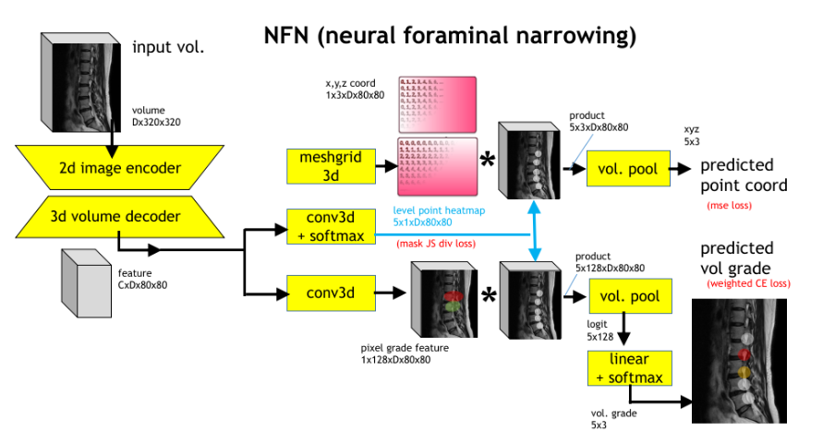
Summary
Figure.1 Deep net architecture for NFN (neural foraminal narrowing) detection

Slide 8
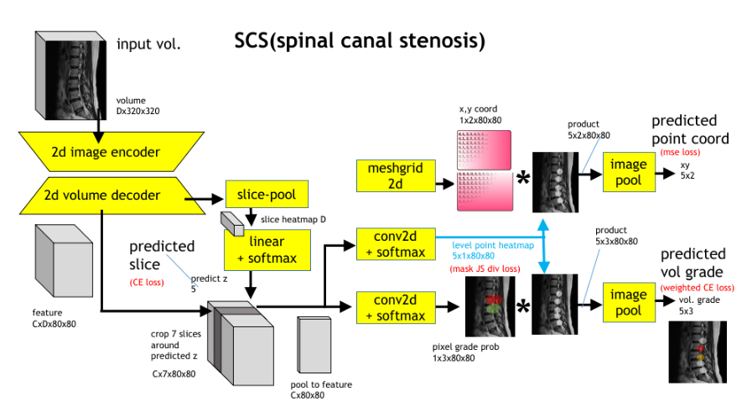
Summary
Figure.2 Deep net architecture for SCS (spinal canal stenosis) detection

Slide 9
Features Selection/
Engineering

Slide 10
Features Selection/Engineering
1. Image encoder
We are using pyramid transformer PVTv2 [2] as image encoder backbone for submission. They have very large context which we think are important to get good results. For example, both left and right level are likely to have the same spine degeneration conditions.
2. Point-masking and pooling The level point heatmap can be seen as learned attention map to select with pixel we should look at for spine degeneration conditions.
[1] “PVT v2: Improved Baselines with Pyramid Vision Transformer” - Wenhai Wanghttps://arxiv.org/abs/2106.13797

Slide 11
Training Methods

Slide 12
Training Methods
Training is straight forward with multi-task loss setup for each net in Figure.1 and 2:
- pixel-wise level point : Jensen-Shannon divergence loss
- pixel-wise grade probability : Cross entropy loss
- volume-wise level grade probability : weighted cross entropy loss
We perform back propagation with ADAM optimizer. Training hyper-parameters - learning rate is from 1e-4 to 1e-5 - training epochs ranges from 50 to 100. - batch sizes is from 3 to 8 volumes. For hardware, we use one Nvidia Ada A6000/48GB Ampere GPU. Powerful GPU makes our training fast and large memory enables us to train with whole 3d volume.
Kaggle Winner Presentation Template

Slide 13
Training Methods
Some observations from training are:
1. Upper bound for grade prediction performance.
- if we use the ground truth level point heatmap and just learn grade prediction, this gives upper bound for grade prediction performance.
2. One-stage networks are challenging to train because the optimal parameters for coordinate prediction are not necessarily the best for grade prediction. - confirmed by observing the loss for level and grade during training iterations. They seem to be competing with each other.
We believe one reason for this is labeling errors, particularly the significant confusion between L5 and S1 level labels. Additionally, the point labels themselves are not very precise.
Kaggle Winner Presentation Template

Slide 14
Important and Interesting Findings

Slide 15
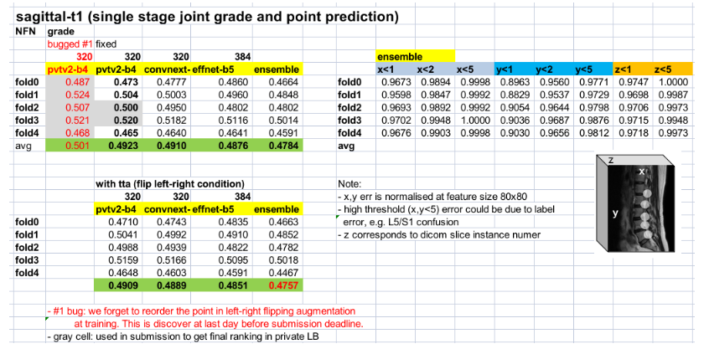
Important and Interesting Findings
Figure.3 Local validation for NFN (neural foraminal narrowing) detection
We had a bug in flip augmentation at train. We forgot to reorder the left right level points (i.e. at training the left is mistakenly labeled as right and vice versus for 50% of the time). We discovered the bug just one day before submission and was unable to correct all models for submission. Hence the final submission consisted of both bugged and unbugged models. We later make post submission after the competition deadline with unbugged models only and showed better results.

Slide 16
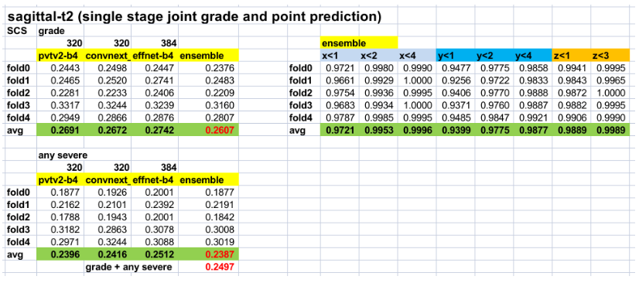
Important and Interesting Findings
Figure.4 Local validation for SCS (spinal canal stenosis) detection

Slide 17
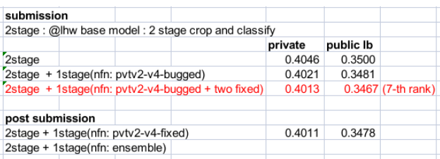

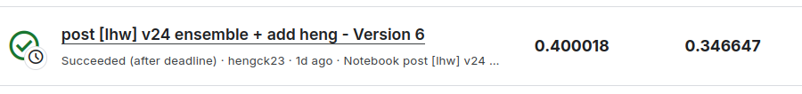
0.4000
0.3466
Figure.5 Public and private leader board submission scores
One-stage NFN model indeed improves results. Blending is: 0.75*2stage + 0.25*1stage 1. The baseline two stage has private /public score of 0.406/0.3500. 2. Even with bugged models only, the improvement is 0.402/0.3481. 3. For unbugged models, we have the best score of 0.400/0.3466. 4. One stage SCS models did not improve results and are not included for final submission. The reasons are unclear. When alone, one stage SCS model are have comparable accuracy as the two-stage counterparts. However after ensemble, the combined results falls a little.

Slide 18
Simple Model

Slide 19
Simple Model
From our report it is sufficient just to use only two stage mode.There will be drop of 5% accuracy though.

Slide 20
Code Review

Slide 21
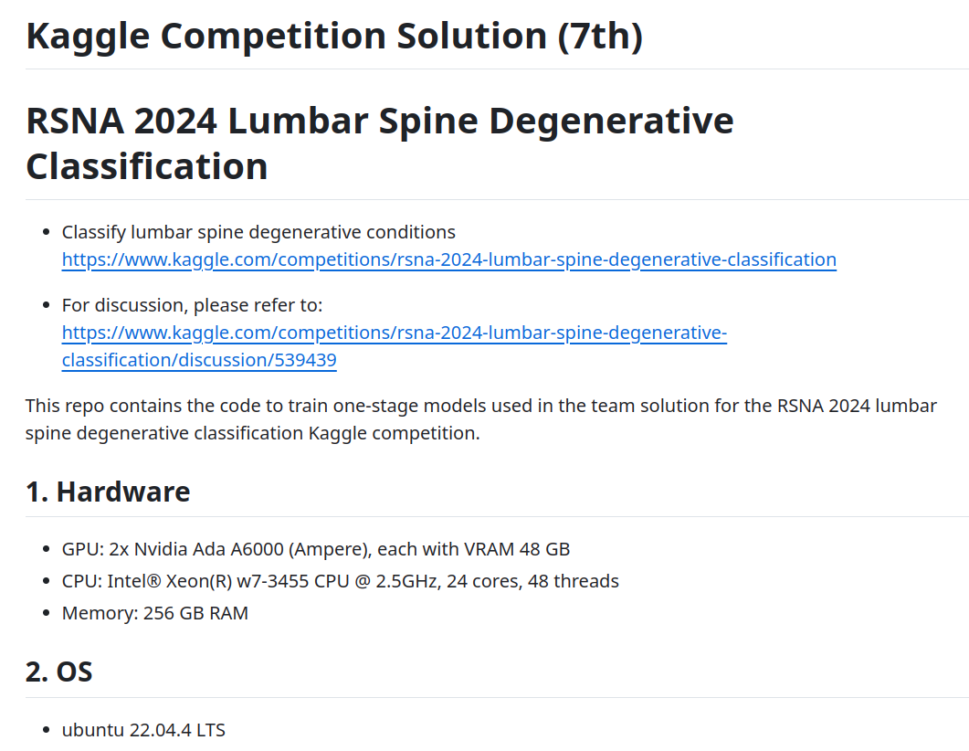
https://github.com/hengck23/solution-rsna-2024-lumbar-spine

Slide 22
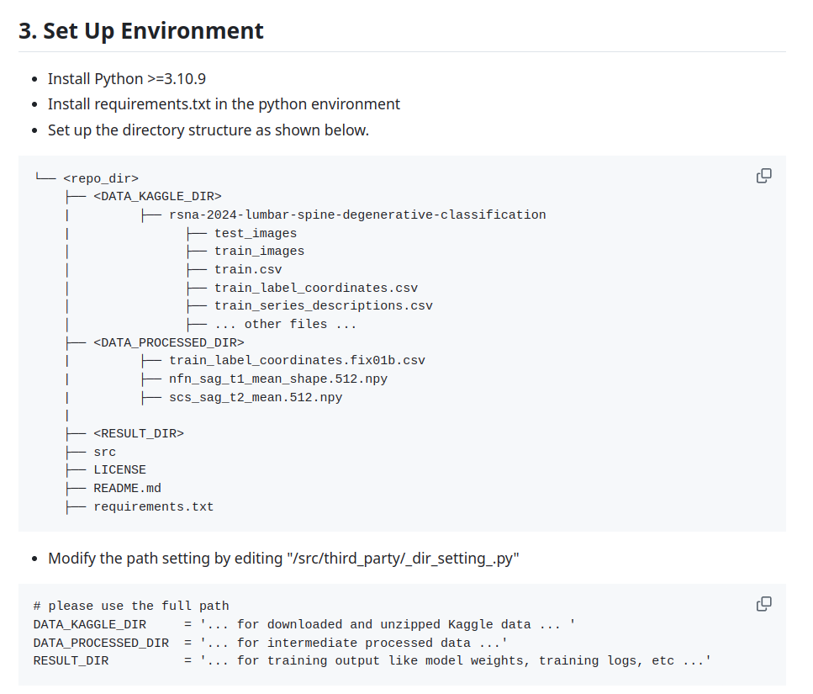

Slide 23
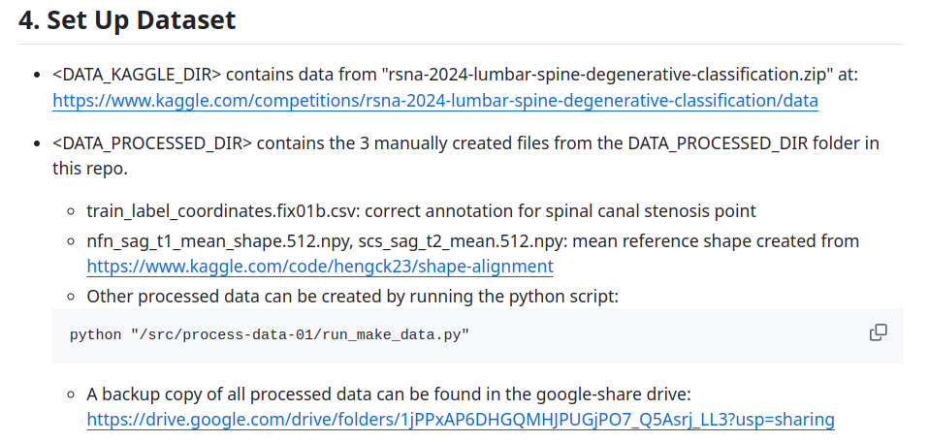

Slide 24
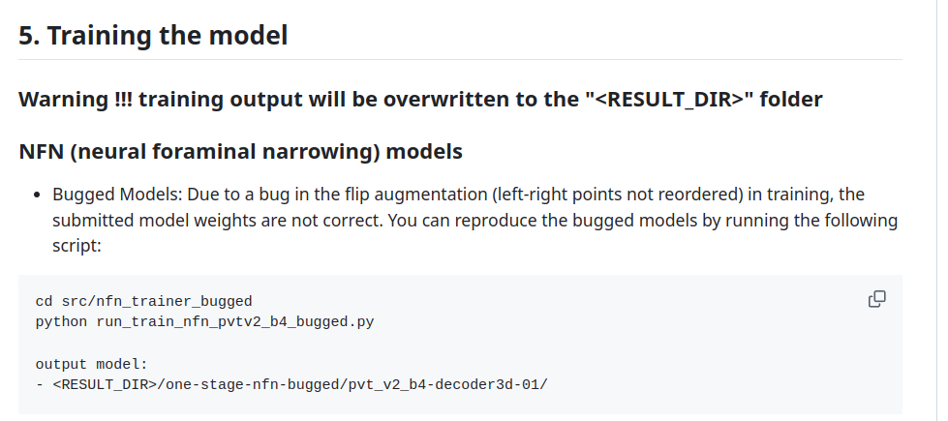
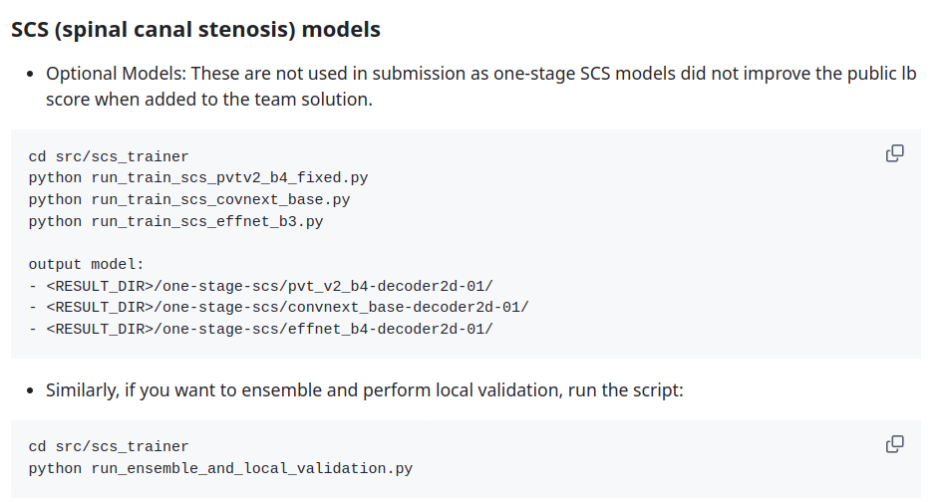

Slide 25
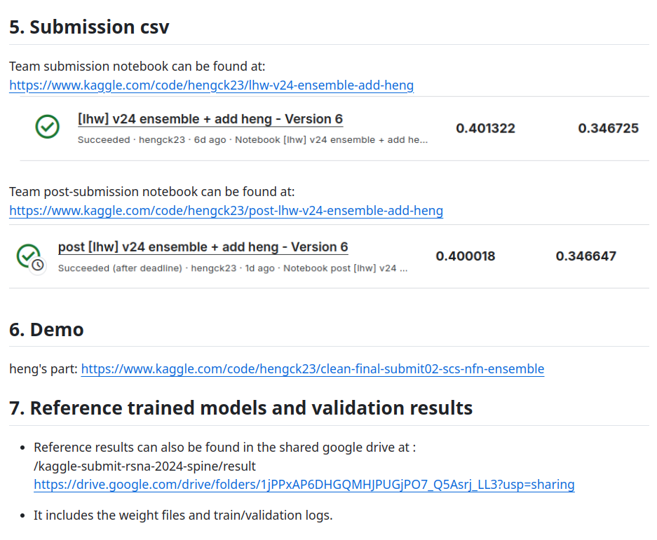

Slide 26
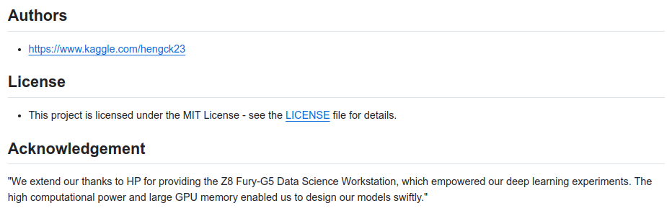

Slide 27
Question and Answer

